Slide 1
South Dakota DENR’s Regulations for Concentrated Animal Feeding Operations
Codington County Planning Commission Work Session August 28, 2017
6:00 PM
Codington County Extension Complex

Slide 2
County Zoning and DENR’s Permit
Legislature has given local government the authority to regulate land use planning (setbacks to homes, churches, etc; roads; odors; etc.).
DENR’s has authority to control water pollution
Generally new operations go through the county zoning process before they go through DENR’s process.
Unless the zoning ordinance requires zoning be done first, there is nothing stopping a producer from going through DENRs process first or doing them at the same time.

Slide 3

Department of Environment
and Natural Resources
“The mission of DENR is to protect public health and the environment by providing environmental monitoring and natural resource assessment, technical and financial assistance for environmental projects, and environmental regulatory services; all done with reduced red tape, expanded e-government functions, and exceptional customer service to promote a prosperous economy while protecting South Dakota's environment and natural resources for today and tomorrow.”
Steven M. Pirner, P.E.
Secretary
(605) 773-5559
Division of Environmental
Services
Vacant, Director
(605) 773-3153
Division of Financial and Technical Assistance
James Feeney, Director
(605) 773-4216
Air Quality
Brian Gustafson, P.E.
(605) 773-3151
Drinking Water
Mark Mayer, P.E.
(605) 773-3754
Geological Survey
Derric Iles, C.P.G.
(605) 677-5227
Petroleum Release
Compensation Fund
Alan Bakeberg
(605) 773-3769
Feedlot Permit
Kent Woodmansey, P.E.
(605) 773-3351
Groundwater Quality
Vacant
(605) 773-3296
Water and Waste Funding
Mike Perkovich, P.E.
(605) 773-4216
Watershed Protection
Vacant
(605) 773-4254
Minerals and Mining
Bob Townsend, C.P.G.
(605) 773-4201
Surface Water Quality
Kelli Buscher, P.E.
(605) 773-3351
DENR Administrative Services
Facilities Management: Vicki Murray, (605) 773-5559
Fiscal Management: Rob Green, (605) 773-4216
Information Services: Kim Smith, (605) 773-3152
Waste Management
Vonni Kallemeyn
(605) 773-3153
Water Rights
Jeanne Goodman, P.E.
(605) 773-3352

Slide 4
Topics
What is a general permit?
History of general permits for concentrated animal feeding operations (CAFOs)
The 2017 General Water Pollution Control Permit for CAFOs and the Permitting Process
The general permit’s shallow aquifer protection requirements
Inspections/enforcement
Producer Training

Slide 5
What is a general permit?
Used by DENR to permit similar activities
Contains standard conditions required by state and federal law
Provides DENR a mechanism to efficiently permit a large number of operations

Slide 6
CAFO General Permit History
In 1993 when South Dakota was delegated the National Pollutant Discharge Elimination System (NPDES) Program by the EPA there were no NPDES permits for CAFOs in place
In 1996 the South Dakota Pork Producers approached the department about working together to put in place a permit because of expected growth in the swine industry. A general permit was issued in 1997.

Slide 7
General Permit History (continued)
In 1997 the South Dakota Department of Agriculture asked the department to put together a permit for all other animal types. That general permit was issued in 1998.
In 2003 a general permit for all concentrated animal feeding operations was issued.

Slide 8
General Permit History (continued)
2007 South Dakota legislative session – SB 9 (34A-2-36.2) was passed requiring concentrated animal feeding operations to operate under a general or individual water pollution control permit
Without a permit concerns were:
  No road map for environmental compliance
  local hearings for conditional use permits would be more controversial

Slide 9
General Permit History (continued)
October 2008 – General permit expired
DENR administratively extended permit anticipating new federal rules addressing court case
November 2008 – Federal regulations were published in Federal Register. Regulations were immediately litigated by both producer and environmental groups.

Slide 10
General Permit History (continued)
Proposed permit and December 16, 2015, contested case hearing public noticed in 10 newspapers and mailed to 931 interested parties by October 8, 2015.
27 parties submitted comments and 11 petitions were received to participate in the contested case hearing.
On December 8, 2015, a request to delay the hearing was received.

Slide 11
General Permit History (continued)
Hearing rescheduled for September 27-29, 2016 with August 2, 2016, newspaper notice and notice on DENR’s one-stop public notice website.
2-1/2 day contested case hearing attended by 80 people. Secretary adopted the permit with changes at the end of the hearing.

Slide 12
General Permit History (continued)
Secretary adopted Findings of Fact and Conclusions of Law on March 10, 2017.
Reissued Permit was effective April 15, 2017. A copy can be found at http://denr.sd.gov/des/fp/2017permit.aspx.
Existing permitted operations continue coverage under the 2003 general permit and have 1- 4 years to get coverage under the 2017 general permit, unless required sooner.

Slide 13
General Permit History (continued)
All CAFOs in SD are required to have permit coverage.
New and Expanding CAFOs need coverage under the 2017 general permit.

Slide 14
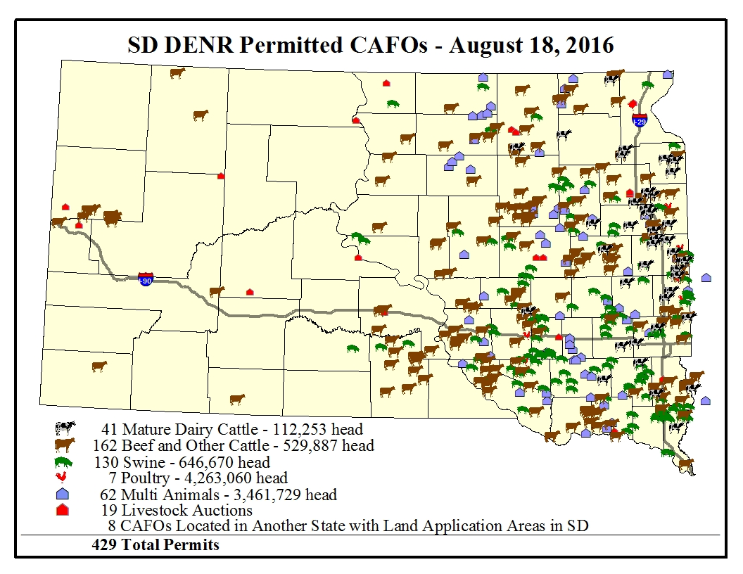


Slide 15
DENR’s General Permit
Includes federal and state requirements ensuring manure management systems are properly designed, constructed, operated, and maintained so they protect the quality of South Dakota’s surface waters;
Includes state requirements protecting shallow aquifers;
Ensures the nutrients generated are land applied following an approved nutrient management plan; and

Slide 16
DENR’s General Permit (continued)
Is understandable by producers, design engineers, and crop consultants so they provide a roadmap for environmental compliance.

Slide 17
Basic Elements of the General Permit

Slide 18
Basic Elements of the General Permit
Definitions
Who needs permit coverage?
Permit application requirements
Permit issuance processes
Effluent Limits
Design, Construction, Operation and Maintenance Requirements to protect surface and ground water
Nutrient Management Planning Requirements
Inspection, Recordkeeping and Reporting Requirements

Slide 19
Who Needs A Permit?
Animal Feeding Operation:
  Animals are stabled or confined for 45 days or more in any 12-month period, and
  No vegetation present during the normal growing season.
  Animal feeding operations under common ownership are a single animal feeding operation if they are within one mile of each other or use a common manure management system or nutrient management plan

Slide 20
Who Needs A Permit? (continued)
An Animal Feeding Operation is a Concentrated Animal Feeding Operation if it is:
  Large
  Medium (determined with an inspection)
    Drainage running through confinement area
    Man-made conveyance to surface water
  Small (designation and based on inspection)
    Same criteria as medium
    Significant contributor of pollutants

Slide 21
Table 1. Number of Animals to Define Large, Medium, and Small Concentrated Animal Feeding Operations
Type of Animal | Concentrated Animal Feeding Operations
Feeding Operation | Large Animal numbers equal to or more than: | Medium Animal numbers equal to: | Small Animal numbers less than:
Dairy cows (mature – milked or dry) | 700 | 200 to 699 | 200
Veal Calves | 1,000 | 300 to 999 | 300
Cattle other than mature dairy cows or veal calves ¹ | 1,000 | 300 to 999 | 300
Swine (weighing more than 55 pounds) | 2,500 | 750 to 2,499 | 750
Swine (weighing less than 55 pounds) | 10,000 | 3,000 to 9,999 | 3,000
Horses | 500 | 150 to 499 | 150
Sheep or Lambs | 10,000 | 3,000 to 9,999 | 3,000
Turkeys | 55,000 | 16,500 to 54,999 | 16,500
Laying hens or broilers ² | 30,000 | 9,000 to 29,999 | 9,000
Chickens, other than laying hens ³ | 125,000 | 37,500 to 124,999 | 37,500
Laying hens ³ | 82,000 | 25,000 to 81,999 | 25,000
Ducks ² | 5,000 | 1,500 to 4,999 | 1,500
Ducks ³ | 30,000 | 10,000 to 29,999 | 10,000
Geese | 30,000 | 10,000 to 29,999 | 10,000

Slide 22
Who Needs A Permit? (continued)
CAFOs
Operations below the large CAFO threshold required to get a permit by local government
Operations can voluntarily get permit coverage
Large CAFO’s in other states land applying manure in SD

Slide 23
State vs NPDES Permit Option
State Permit
NPDES Permit
Any discharge from an operation’s manure management system is a permit violation. The Natural Resources Conservation Services’ Soil Plant Air Water (SPAW) model is used to verify the system is designed to not discharge
The permit allows certain operations to have a discharge from their manure containment system in the event of a 25-year, 24-hour storm event if the manure management system is properly designed, constructed, operated, and maintained

Slide 24
State vs NPDES Permit Option (continued)
State Permit
NPDES Permit
Applications for new operations or for those increasing their animal numbers are public noticed in the local paper and on DENR’s One-Stop Public Notice website
DENR will respond to any comments received in the 30 day comment period
Applications for new operations and those making major modifications (see definitions) are reviewed and the Division’s recommendation is public noticed in the local paper and DENR’s One-Stop Public Notice website
DENR will respond to any comments received in the 30 day comment period

Slide 25
State vs NPDES Permit Option (continued)
State Permit
NPDES Permit
No opportunity for contested case hearing
Opportunity for contested case hearing

Slide 26
Permit Application Process
Permit Application Process Checklist and Flowchart: http://denr.sd.gov/des/fp/documents/2017ApplicationChecklist.pdf

Slide 27
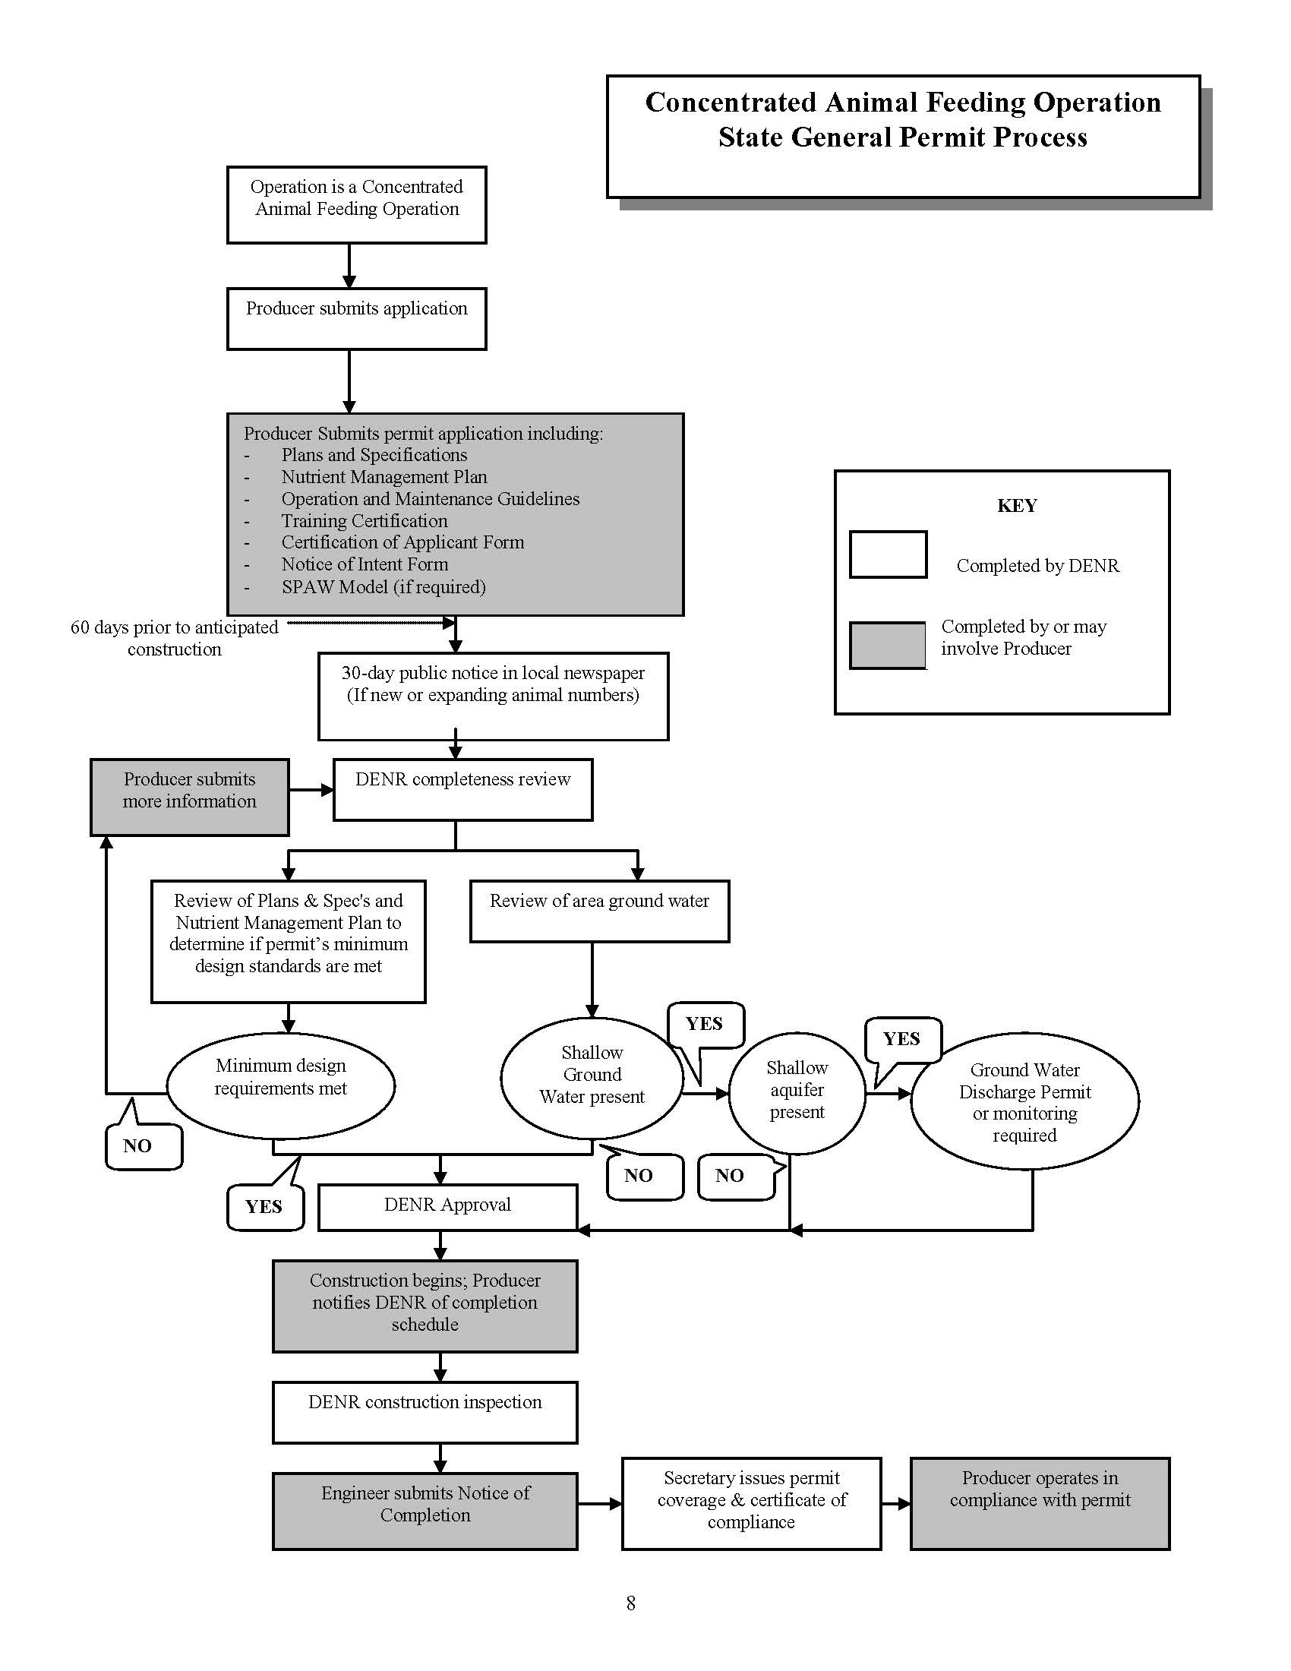
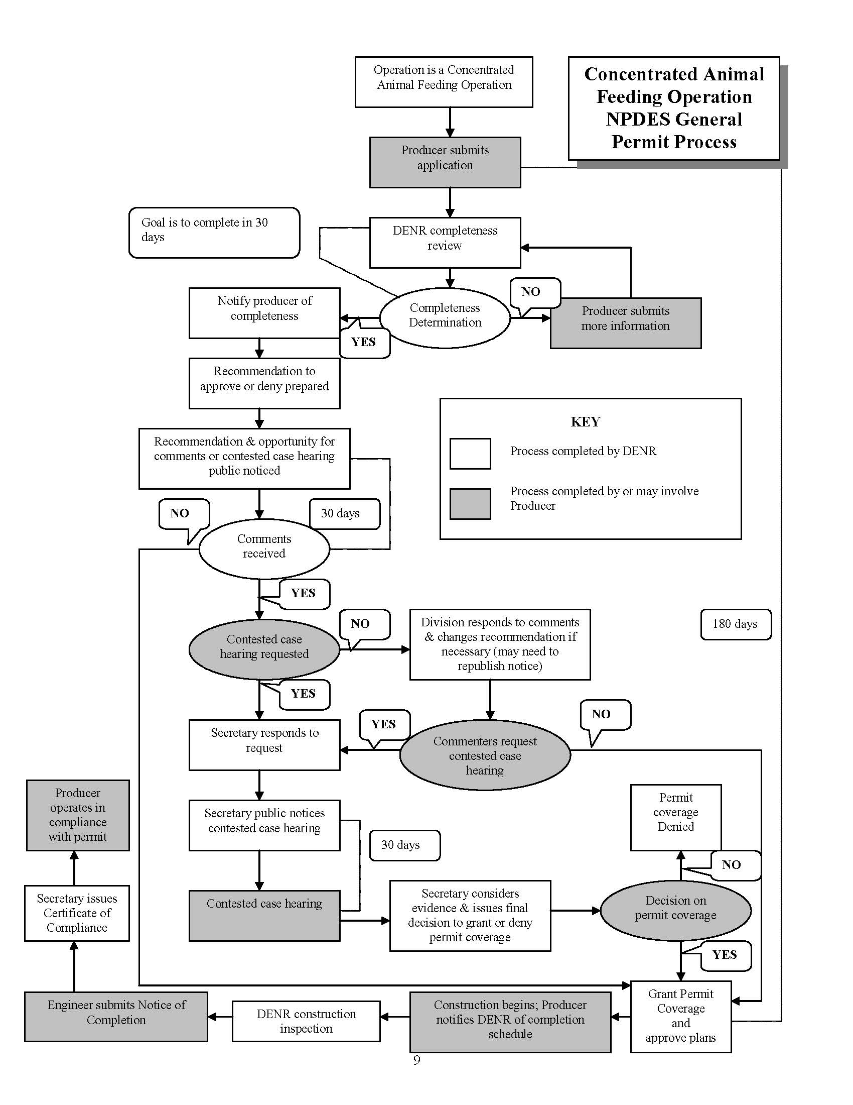

Slide 28
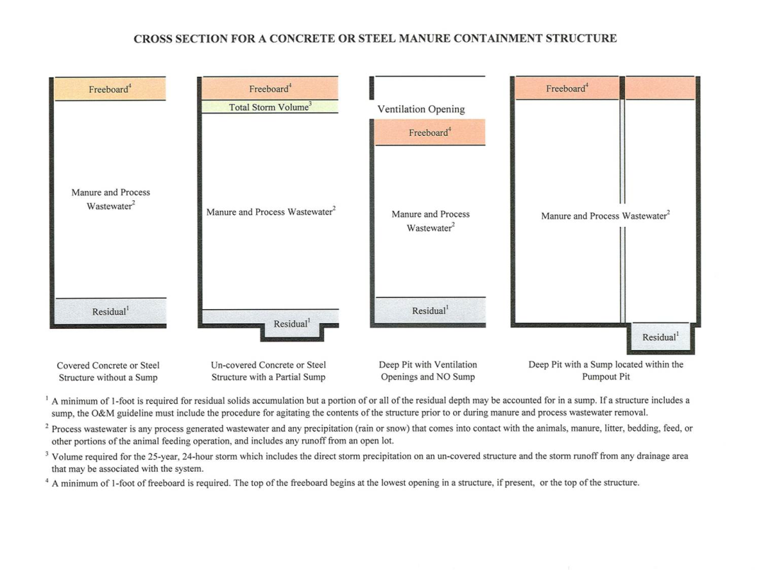
DENR Permit Application Review
Is the operation a “bad actor”? (anyone with 10% or more ownership)
Does the manure containment system meet the required capacity requirements (270 or 365 days) and other required storage volumes? [see Appendix H of the permit (below) for cross section information] reviewed.

Slide 29
DENR Review (continued)
Does the application meet the required clay liner, concrete, and other design standards in the permit?
Does the application meet the permit’s initial nutrient management plan requirements?
Has the producer attended the SDSU producer training class within the past three years?
Are the liquid manure containment system or land application fields located over a shallow aquifer?

Slide 30
Shallow Aquifer Protection

Slide 31
Shallow Aquifer as defined in SDCL 34A-3A-24
SDCL 34A-3A-24 defines a shallow aquifer as any aquifer having the following characteristics:
  The aquifer is within fifty feet or less below the land surface with fifteen feet or less of continuous, overlying, extremely low permeability geologic material, such as clayey till or shale. Weathered till or highly fractured weathered shale is not an extremely low permeability material for purposes of this section; or
  The aquifer is greater than fifty feet but less than one hundred feet below the land surface with thirty feet or less of continuous overlying low to extremely low permeability geologic material that may be a combination of weathered and unweathered till, shale, or till and shale.

Slide 32
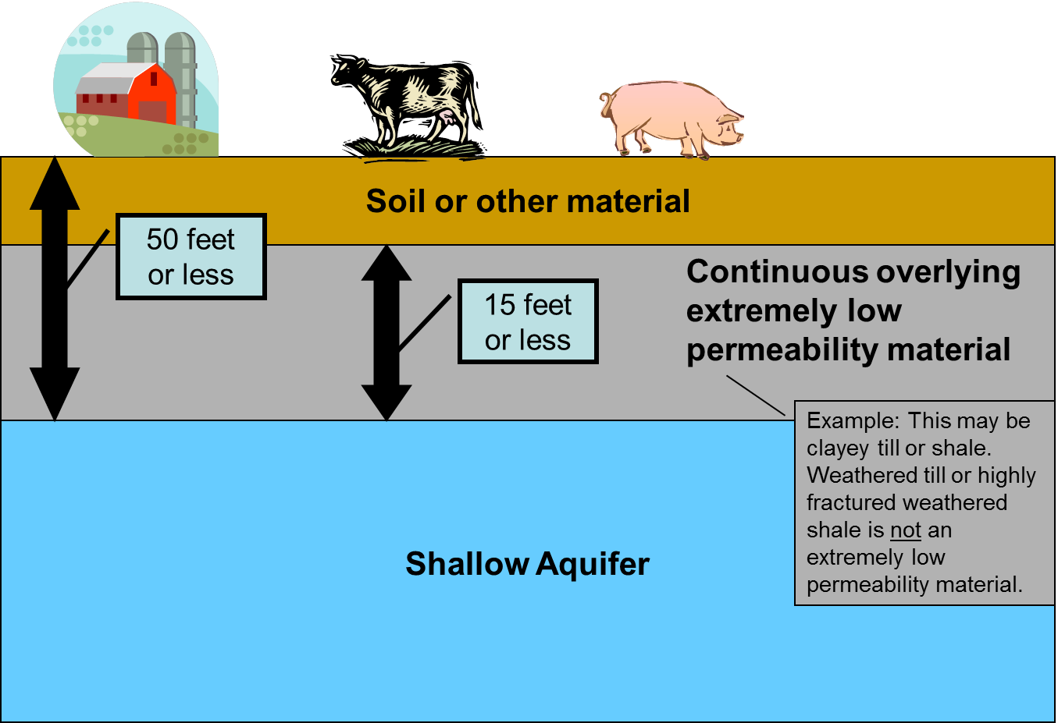
Shallow Aquifer as defined in SDCL 34A-3A-24

Slide 33
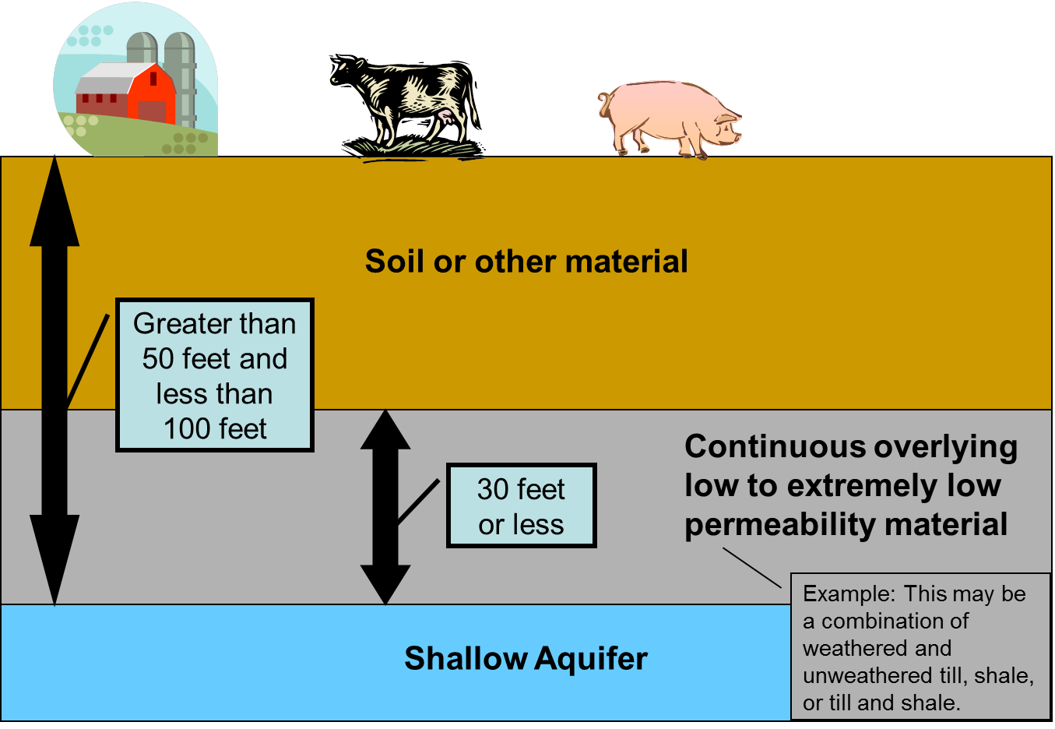
Shallow Aquifer as defined in SDCL 34A-3A-24

Slide 34
Soil Boring Requirements
The general permits contain soil boring requirements designed to provide information to help determine if the proposed process wastewater containment structure is located over a shallow aquifer. The requirements are:
A minimum of two soil borings or at least one soil boring per acre of containment structure at the maximum operating level
All soil borings must be located within 200 feet of the proposed process wastewater containment structure
All soil borings must extend a minimum of six feet below the bottom of the containment structure
At least one of the soil borings must be a deep subsurface boring characterizing the subsurface hydrogeology of the site.

Slide 35
Soil Boring Requirements (continued)
The deep subsurface soil boring must extend a minimum of 25 feet below the ground surface and must continue until one of the following criteria is met:
  At least 15 continuous feet of extremely low permeability, geologic material (unweathered clayey till or shale) is encountered in the soil boring;
  At least 30 continuous feet of low to extremely low permeability, geologic material (weathered or unweathered till or shale) is encountered, if the boring is greater than 50 feet in depth;
  The boring reaches an aquifer or bedrock; or
  A total depth of 100 feet.

Slide 36
Containment Structure Review Process
DENR staff review the following information to determine whether the containment structure is located over a shallow aquifer:
On-site hydrogeologic information (on-site soil borings)
The First Occurrence of Aquifer Materials Maps
County Aquifer Studies
Local well completion reports
Information from the Department’s Geological Survey Lithologic Logs Database
If the containment structure is located over a shallow aquifer, the table in Appendix G of the general permit, is used to determine if groundwater monitoring or a groundwater discharge permit is required.

Slide 37
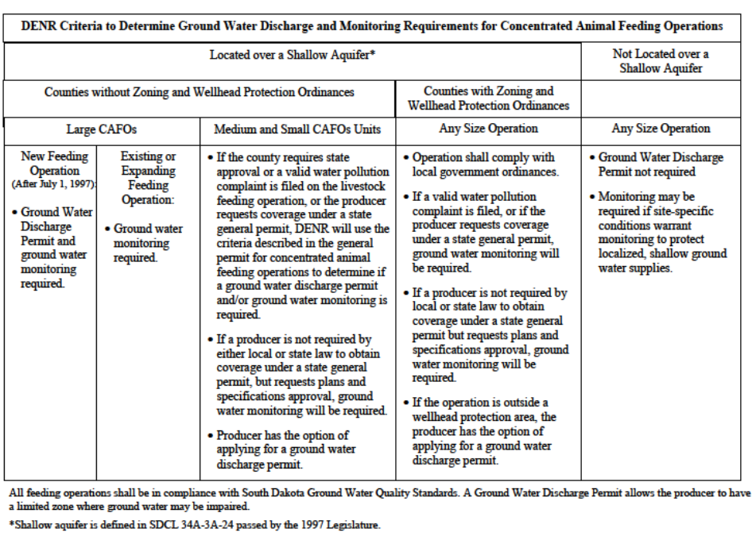

Slide 38
Groundwater Monitoring (continued)
If the process wastewater containment structure is located over a shallow aquifer and the Feedlot Permit Program’s review does not indicate a groundwater discharge permit is required, the operation is required to install monitoring wells and conduct groundwater monitoring.
A minimum of three groundwater monitoring wells must be installed around the process wastewater containment structure and must be installed by a South Dakota licensed well driller.
The monitoring wells must be sampled on a quarterly basis for the following parameters:
  Total Dissolved Solids;
  Sulfate, Dissolved;
  Nitrate as Nitrogen;
  Ammonia – Nitrogen, dissolved NH₄⁺-NH₃ as Nitrogen;
  Chloride, Dissolved; and
  Water Table Elevation.

Slide 39
Groundwater Monitoring (continued)
At least one round of sampling is required prior to placing process wastewater in the containment structure.
If groundwater does not appear to be impacted after one year of sampling, the producer may request to reduce the monitoring frequency.
If the groundwater appears to be impacted, the department may require more frequent monitoring and reporting, groundwater remediation, additional sampling parameters, or a groundwater discharge permit.

Slide 40
Land Application Site Review
New and revised land application sites are also reviewed to determine if they are located over a shallow aquifer using the following materials:
The First Occurrence of Aquifer Materials Maps
County Aquifer Studies
Local well completion reports
Information from the Department’s Geological Survey Lithologic Logs Database

Slide 41
Land Application Site Review (continued)
The soil sampling requirements included in the 2003 general permit and the 2017 general permit were developed in cooperation with South Dakota State University, the South Dakota Department of Agriculture, and the South Dakota Natural Resource Conservation Service.
Annual soil samples from 0 to 2 feet are required on all manure land application fields prior to manure application.
If a land application site is found to be located over a shallow aquifer additional soil sampling is required.
The producer has the option to conduct two different types of additional soil sampling.

Slide 42
Additional Soil Sampling
The producer may elect to conduct additional deep soil sampling which consists of taking nitrate-nitrogen soil samples from 2 to 4 feet in addition to the standard nutrient management plan requirement of nitrate-nitrogen soil samples from 0 to 2 feet.
The producer may elect to take soil samples for nitrate-nitrogen from 0 to 2 feet both prior to manure application and within four weeks after harvesting the crop.

Slide 43
Additional Soil Sampling (continued)
The producer may elect to take soil samples for nitrate-nitrogen from 0 to 2 feet both prior to manure application and within four weeks after harvesting the crop.
  If the residual nitrate-nitrogen in the post-harvest soil samples is above 100 pounds per acre, the field will not be available for land application until one full growing season has passed. If a soil sample is taken the following year and shows that the nitrate-nitrogen has dropped below 100 pounds per acre, manure application may resume.

Slide 44
DENR Inspections
Construction Inspections:
  At least one construction inspection (ARSD 74:57:01:03)
Compliance Inspections:
U.S. EPA requires permitted CAFOs be inspected every 5 years.
DENR inspects at least annually or once every three years (ARSD 74:57:01:04 and 74:57:01:05)
Violations found during inspections are followed up by:
  Warning letters,
  Administrative enforcement actions, or
  Referral to the Office of Attorney General for resolution.

Slide 45
DENR Inspections (continued)
U.S. EPA staff have conducted joint or oversight inspections at permitted CAFOs and have given the Feedlot Permit program positive feedback.
Penalties are calculated using a penalty policy that was part of the department’s NPDES delegation package. Penalties are based on the magnitude of the violation or its effects, environmental damage, willfulness, violation history, cooperation, mitigating factors, and economic advantage for noncompliance.
U.S. EPA has reviewed DENR penalty calculations yearly.
U.S. EPA do other reviews as part of our delegated NPDES program oversight.

Slide 46
DENR Inspections (continued)
Closure Inspections:
Required before terminating permit coverage (ARSD 74:57:01:06)
Complaint Inspections:
Requires a complaint form or complaint from government official acting in their official capacity http://denr.sd.gov/des/sw/eforms/E0424LDV1-ComplaintForm.pdf.

Slide 47
Producer Training
The general permit requires the producer or their onsite representative to attend a DENR approved environmental training course on proper operation and maintenance of a manure management system and nutrient management planning
SDSU manages the only approved training course which is offered between quarterly to semiannually
Topics include water quality, livestock nutrition options for reducing nitrogen and phosphorous, DENR’s permit program, land application of manure – nitrogen and phosphorous management, land application worksheets, soil erosion and infiltration, and air quality and odor.

Slide 48
Producer Training (continued)
Recent training reached participants from livestock operations that represented approximately
22,500 animals in the beef industry,
4,000 dairy cows,
60,000 pigs,
5 million laying hens, and
3,000 sheep.
Survey results showed a 21 to 32 percent increase in the overall understanding of the topics, and more than 63 percent of the participants said they plan to adopt certain practices they learned at the training sessions.

Slide 49
Nutrient Management Planning
Nutrient management planning can ensure that the 4 R’s (Right rate, Right source, Right application method, and Right application timing) provide the proper amount of nutrients to the crop where it is needed while protecting surface and ground water.

Slide 50
Nutrient Management Planning
The producer shall inject, or incorporate any liquid manure or process wastewater within 24 hours of application to non-vegetated cropland. If the process wastewater/liquid manure is surface applied, sprinkled, or spray irrigated to cropped fields, grass, alfalfa, pasture land, or no till cropland, incorporation is not required.
The producer shall incorporate any solid or semi-solid manure within five days of application to non-vegetated cropland. If the application area is a cropped field, alfalfa, grass, pasture land, or no-till cropland, incorporation is not required.
Buffer zones and setbacks may be applicable and required.

Slide 51
Nutrient Management Planning (continued)
Initial Nutrient Management Plan – part of the permit application showing the operation has adequate land available for the nutrients generated. The plan includes the application method and crop rotation for each field, agreements with landowners for fields not owned by the producer, soil test results for all fields, maps showing buffer areas and setbacks, and emergency fields for application to saturated, snow covered, or frozen ground.

Slide 52
Nutrient Management Planning (continued)
Annual Nutrient Management Plan – takes the initial nutrient management plan, current manure and soil tests, and expected yield goals to determine whether application is based on nitrogen need, phosphorous crop removal, or if application isn’t allowed and determines the application rate. An Excel spreadsheet maintained by the Natural Resources Conservation Service can be used as part of the initial plan and to determine the annual plan for each field. The permit also allows the use of precision agriculture for the annual plan.

Slide 53
The End
For more information contact DENR’s Feedlot Permit Program at (605) 773-3351 or visit our website at http://denr.sd.gov/des/fp/cafo.aspx

